Slide 1
Crossing Blackout Valley Planning for 2030-2040
Paul J. Hibbard
Raab Roundtable
December 2021

Slide 2
Why Discuss Hydrogen and Long-Duration Storage?
The Setting:
Focus on electrification
Decreasing GHG emissions economy-wide
Increasing electricity demand
Continued generation from: hydro, existing renewables, nuclear
Some short-duration storage operable in some hours
Increasing renewable generation, which effectively offsets natural gas generation on a one-to-one basis as it comes on line
The Result:
Blackout Valley: residual energy demand after all of the above

Slide 3
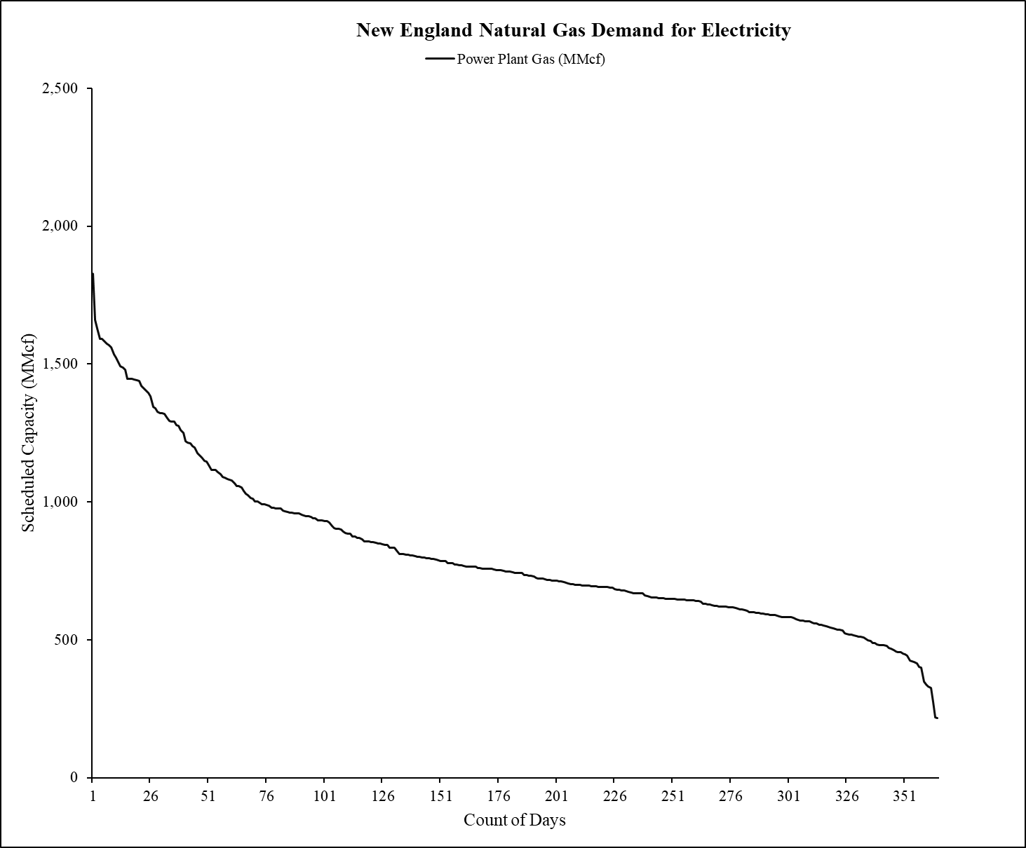
The Residual
Power system GHGs determined by area under the curve (resource mix, efficiency of remaining gas-fired generators)
Energy needed to preserve power system reliability
The area under the curve
Fully determined by the quantity of GWh generated by new renewable resources
Next 10-15 years:
All or mostly natural gas-fired generation
Today’s topic: years 10-20
Natural gas?
Hydrogen (turbines, fuel cells)?
Long-duration storage?
Other?
2025
2030
2035

Slide 4
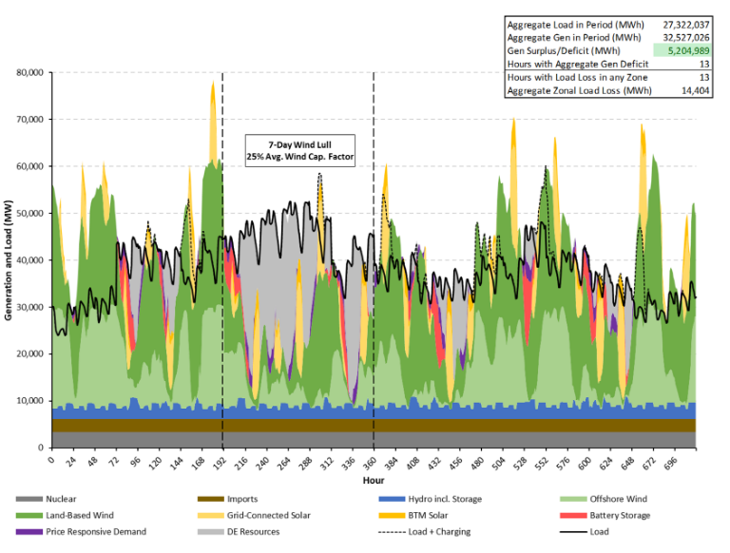
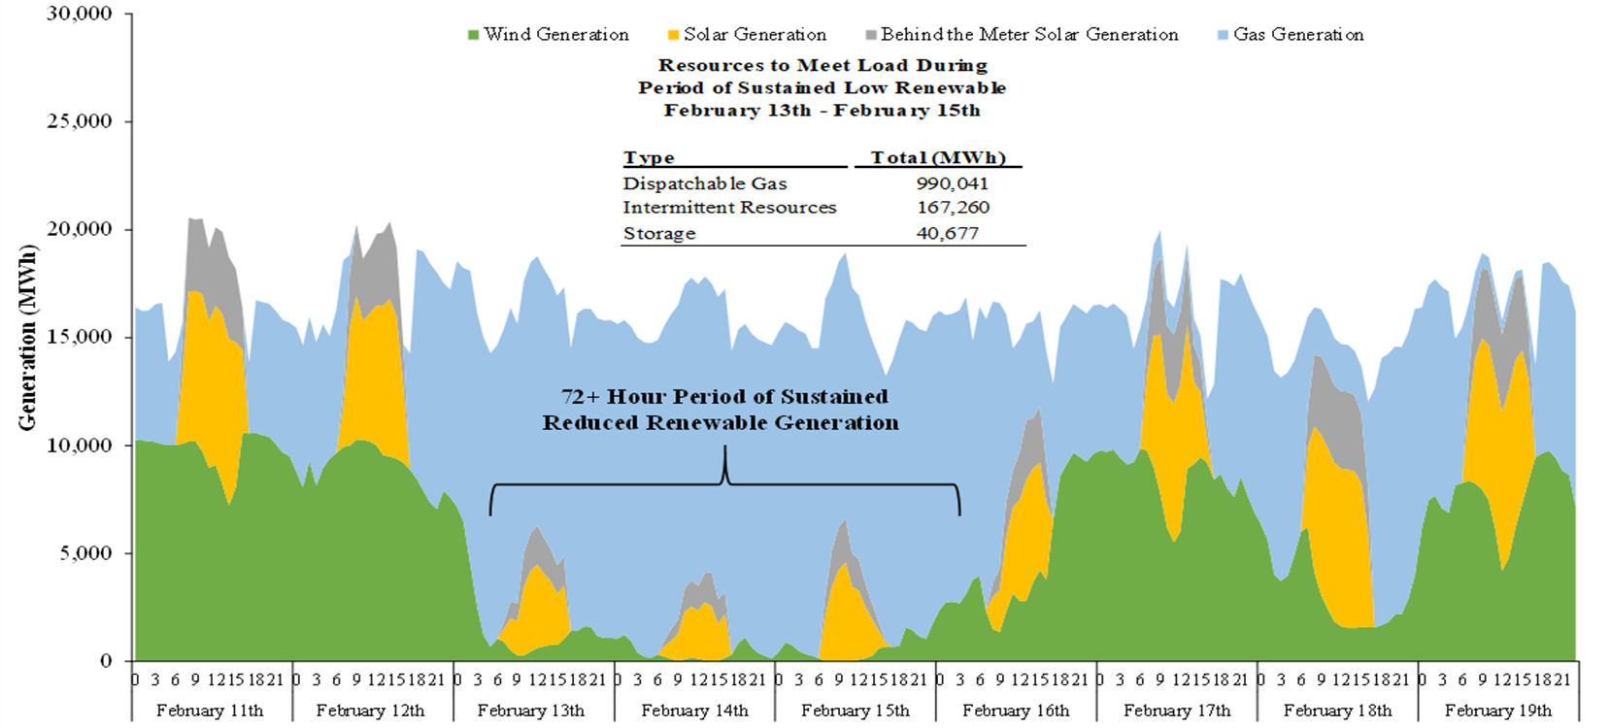
Blackout Valley
Analysis Group studies of rapid expansion of variable resources in New England and New York
Extended periods of low solar/wind output, when resources are insufficient to meet reliability needs
Ramping requirements on the order of 15-20 GW over just a few hours in each system
New England
New York
New England values are net of baseload hydro, nuclear

Slide 5
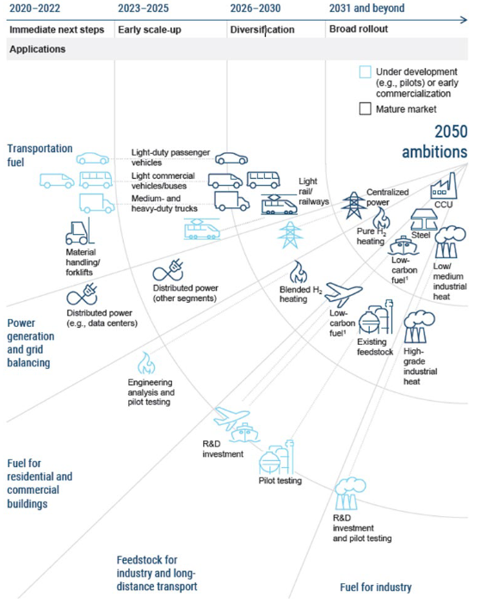
Why Hydrogen?
Being Honest? It Looks Like a Fossil Fuel
Energy density: extreme energy content per unit volume, exceeding fossil fuels
Ubiquity: H₂O is everywhere, so are low/zero-carbon energy input sources (wind, sun, etc)
Storage: can be stored for multiple applications in a variety of settings
Transportability: energy density and phase flexibility provide for high transportability
Applications: can be used in transportation, buildings, industry, electricity generation
Infrastructure: can make use of existing pipeline infrastructure; uses similar fueling infrastructure as gasoline, diesel
Renewable utilization: effective use of “spilled” renewables; transportability allows for utilization of renewable electricity potential distant from load
The last “power mile:” can support reliable power system operations during periods of high loads and low variable power production
Cost?: Can it be a cost-effective GHG abatement option?
Source: Noah D. Meeks, Hydrogen & Integrated Electrolyzer Systems Panel, presentation to the Hydrogen Shot Summit,September 1, 2021,

Slide 6
Paul J. Hibbard
Principal
Analysis Group, Inc.
phibbard@analysisgroup.com
617.425.8171

